Slide 1

EmPhAsIS Empowering Pharmacists in Asthma management through Interactive SMS
Baseline Procedures:
Consenting and Enrolling Patients
emphasis.core.ubc.ca
Click for more information

Slide 2
EmPhAsIS Empowering Pharmacists in Asthma management through Interactive SMS
To review how to recruit and screen a potential study participant,
please see the previous mini-webinar on:
“Baseline Procedures: Recruiting and Screening Patients”
Once you have identified a study participant who is willing to participate in the study and fulfills in the inclusion criteria, you are now ready to start obtaining consent and officially enrolling the patient into the study!

Slide 3


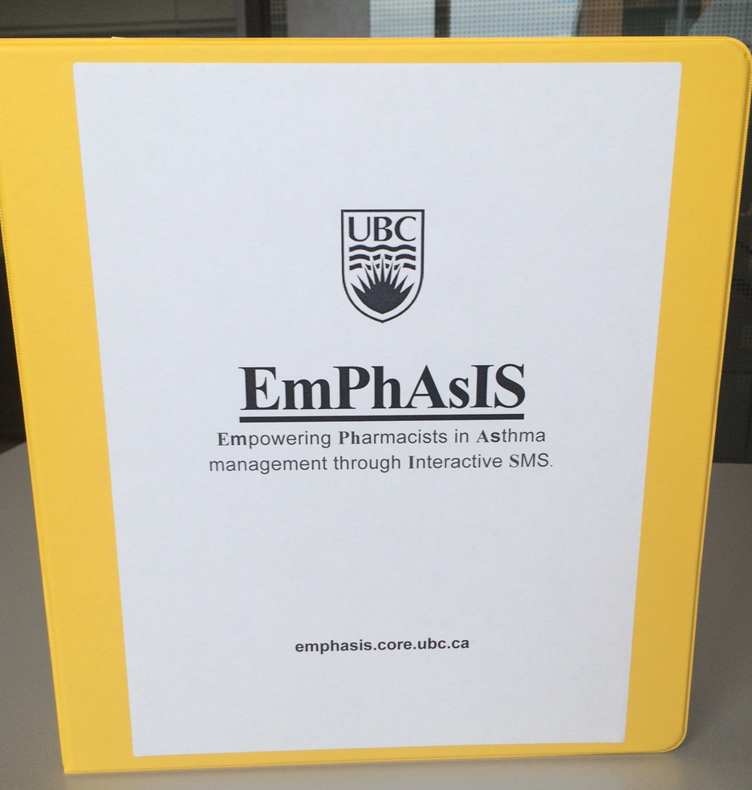
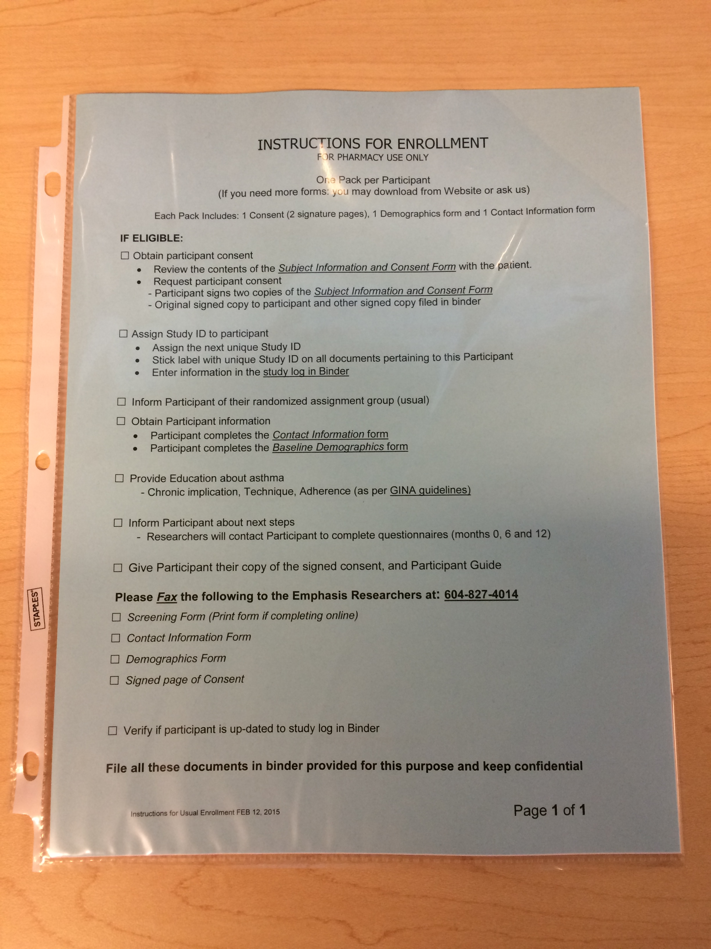
+
For Eligible Patients
In your binder
10 Enrolment Packages (in plastic covers)
Instructions
Subject Information and Consent Form
Contact Form
Demographic Form
Participant Guide
[Magnet – Intervention Group only]
Use 1 package per eligible patient

Slide 4
1. Consent Eligible Patients
+
Important part of enrollment process
Review Subject Information and Consent Form with patient
Have patient sign the 2 copies of page 9
1 copy stapled to form → Patient takes home
1 copy not stapled → Fax to UBC and File in binder
AFTER the patient has signed the consent form, you may inform him/her of the study group assignment

Slide 5
+
2. Complete Enrolment
Complete Contact and Demographics forms
Have patient complete
Contact Form
Demographic Form

Slide 6
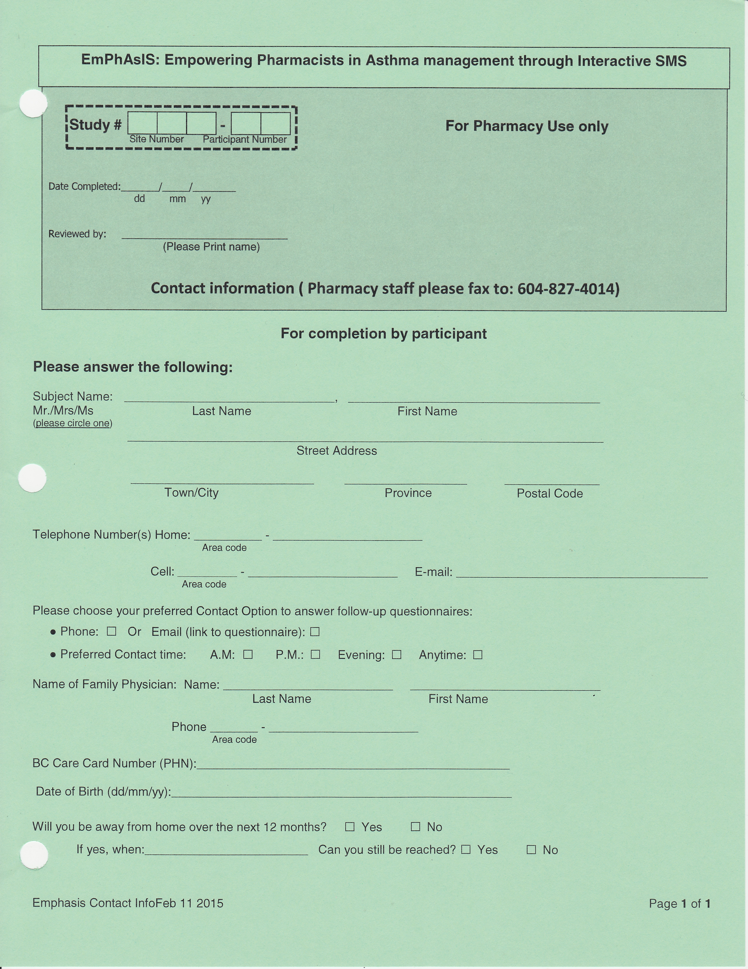
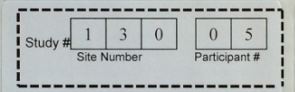
+
2. Complete Enrolment
Contact Information Form
Please stick the Patient Study ID sticker onto the form
Patients can complete the contact form themselves, but verify that ALL FIELDS are completed!

Slide 7
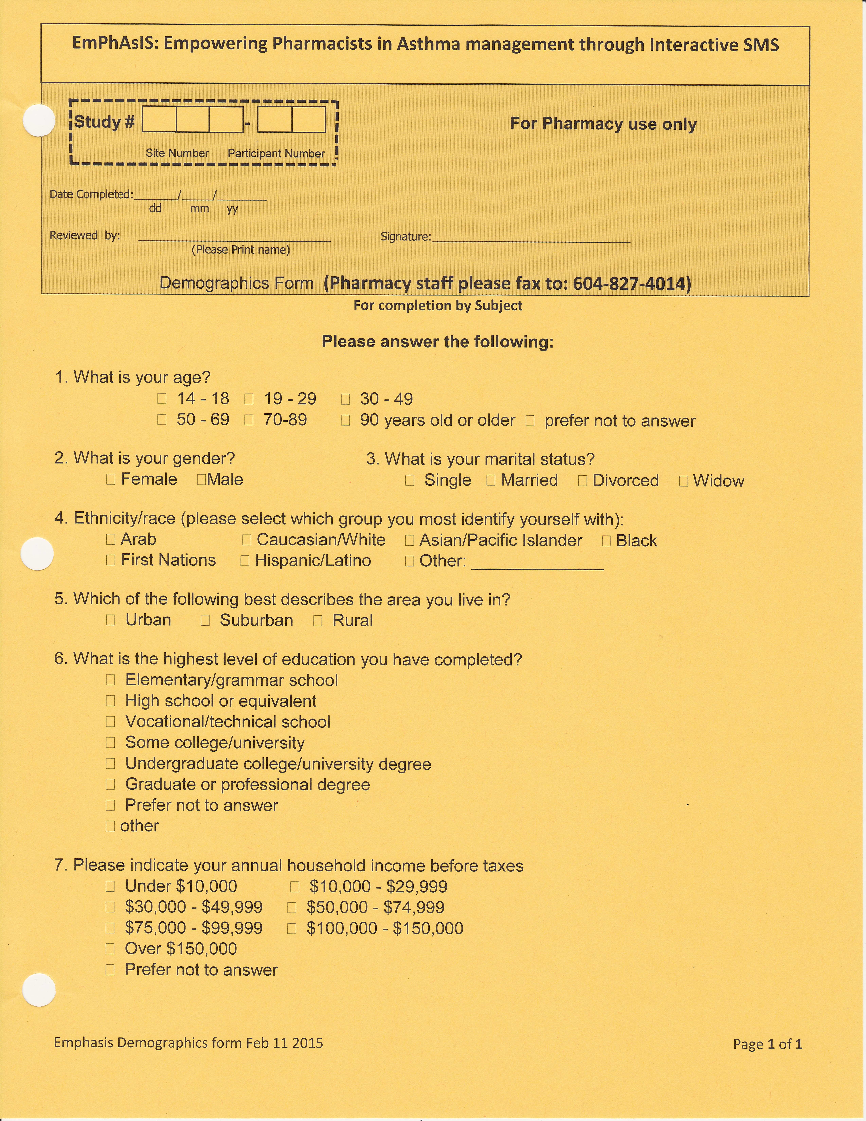
+
2. Complete Enrolment
Demographic Form
Please stick the Patient Study ID sticker onto the form
Patients can complete the contact form themselves, but verify that ALL FIELDS are completed!

Slide 8
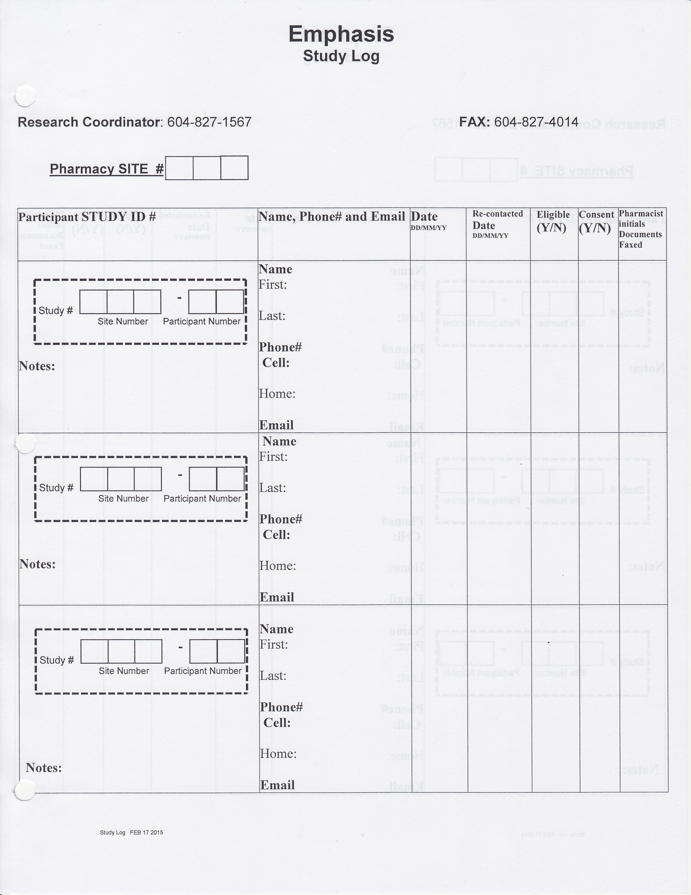
2. Complete Enrolment
+
Once the patient has completed the Contact Form and the Demographic Form…
Fax to UBC 604-827-4014
File in your binder (“Completed Forms” tab)
Update the Study Log
Found at the front of your binder

Slide 9
2. Complete Enrolment
Fill in your Site #
(i.e. 007)
Please stick the Patient Study ID sticker onto the form
Fill in patient name and relevant contact information

Slide 10
+
3. Notify Physician
Fax the Physician Letter to physicians in your community

Slide 11
Congratulations!
You have now successfully consented and enrolled a patient into the study!
If you are an Usual Care Pharmacy, please see next mini-webinar on:
“Baseline Procedures: Usual Care Pharmacy, Next Steps”
If you are an Intervention Pharmacy, please see next mini-webinar on:
“Baseline Procedures: Intervention Pharmacy, Next Steps”

Slide 12
EmPhAsIS Empowering Pharmacists in Asthma management through Interactive SMS
Questions?
Please do not hesitate to contact us
Dr. Mary De Vera at 604-827-2138 (mdevera@mail.ubc.ca)
Research Coordinator (Louise) at 604-827-1567 (louisega@mail.ubc.ca)
Fax: 604-827-4014
Mailing Address
2405 Wesbrook Mall, Vancouver BC, Canada V6T 1Z3

